Slide 1
Speech Enhancement
2020/07/08

Slide 2
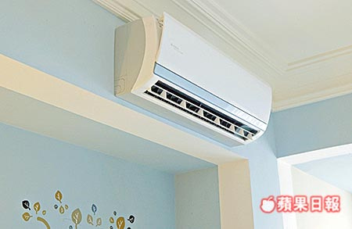
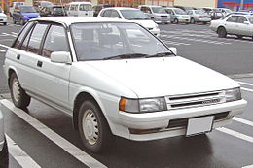
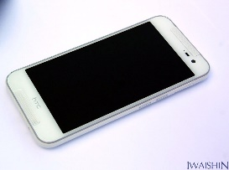
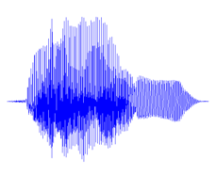
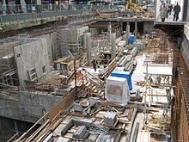
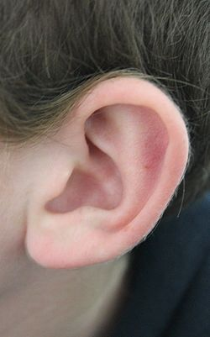

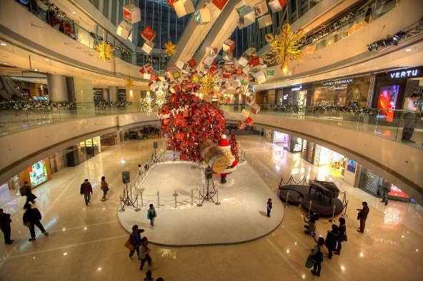
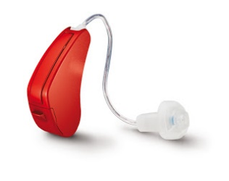
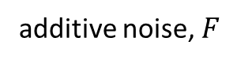
Introduction
The goal of speech enhancement (SE) is to reduce noise components, and thus enhance the SNR of noise-corrupted speech.
Clean-like
speech
Clean speech
additive noise, $F$
denoise devices
Notes:
這張圖是我們一班生活中

Slide 3
Introduction
Improving speech’s quality and intelligibility
Pre-processor for other speech processing application
Automatic speech recognition (ASR)
Speaker verification

Slide 4
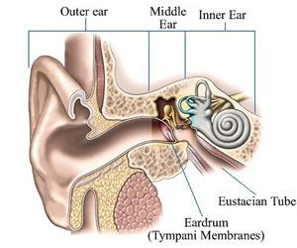
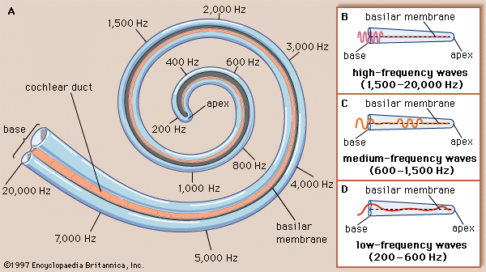
Introduction
In spectrum domain STFT !
However, there are real, imaginary, magnitude and phase parts in a spectrum domain. Magnitude spectrogram !
Notes:
外耳中耳內耳
基底膜 柯氏器
內毛細胞
時域轉頻遇
人工電子耳

Slide 5
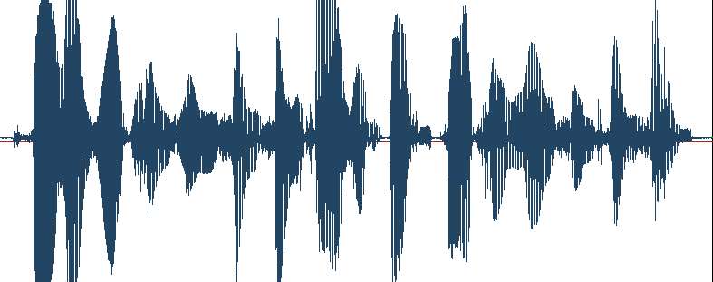
Introduction-STFT
Terminology Used in Framing
Frame Duration (N): the length of time over which a set of parameters is valid. Frame duration ranges between 10 ~ 25 ms
Frame Period (L): the length of time between successive parameter calculations (Target Rate)
Frame Rate: the number of frames computed per second
Frame Duration N
Frame Size
Frame Period (Target Rate) L
frame m
frame m+1 ….. etc.
Parameter
Vector
Size
Speech Vectors or Frames
Notes:
Window size
Overlap hoplength

Slide 6
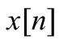
Introduction-STFT
One dimensional
Speech
Signal
Two dimension
$$\text{x}[\text{n}]$$
Spectral
Shaping
Framing
and
Windowing
Magnitude
Spectral
Analysis
Discrete Fourier
transform
Phase
Notes:
二維的複數
傅立葉轉換對稱

Slide 7
Methods
Traditional SE Approaches
Minima controlled recursive averaging (MCRA)
Weiner filter
MMSE
MAPA
Deep Neural Network
Notes:
有無target
supervised

Slide 8
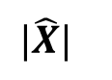
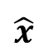
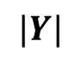
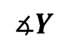
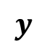
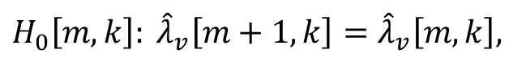

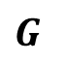
Methods - Unsupervised speech enhancement
$$∡Y$$
$$y$$
STFT
ISTFT
$$\hat{x}$$
Speech Enhancement System
$$|Y|$$
$$⨂$$
$$|\hat{X}|$$
Noise
Estimator
Gain
Estimator
$$G$$
Minima controlled recursive averaging (MCRA):
$$H_{0}\left[m,k\right]: {\hat{λ}}_{v}\left[m+1,k\right]={\hat{λ}}_{v}\left[m,k\right],$$
if speech exists.
$$H_{1}\left[m,k\right]: {\hat{λ}}_{v}\left[m+1,k\right]=α_{v}^{mcra}[m,k]{\hat{λ}}_{v}\left[m,k\right]+\left(1−α_{v}^{mcra}\left[m,k\right]\right)|Y\left[m,k\right]|^{2},$$
if speech doesn’t exist.
Notes:
VAD
兩個stage

Slide 9
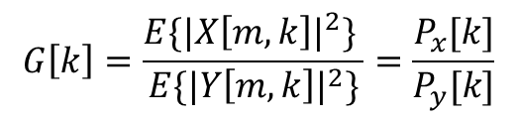
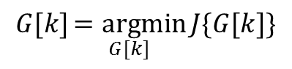
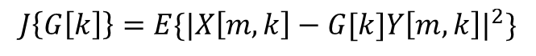
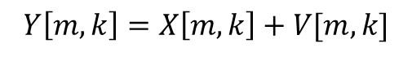
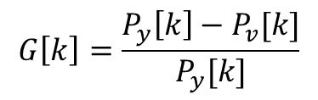
Methods - Unsupervised speech enhancement
$$∡Y$$
$$y$$
STFT
ISTFT
$$\hat{x}$$
Speech Enhancement System
$$|Y|$$
$$⨂$$
$$|\hat{X}|$$
Noise
Estimator
Gain
Estimator
$$G$$
Wiener filter:
$$Y\left[m,k\right]=X\left[m,k\right]+V[m,k]$$
$$G\left[k\right]=\frac{E\{|X\left[m,k\right]|^{2}\} }{E\{|Y\left[m,k\right]|^{2}\}}=\frac{P_{x}[k]}{P_{y}[k]}$$
$$J\left\{G\left[k\right]\right\}=E\{|X\left[m,k\right]−G[k]Y\left[m,k\right]|^{2}\}$$
$$G\left[k\right]=\frac{P_{y}\left[k\right]−P_{v}[k]}{P_{y}[k]}$$
$$G[k]\underset{G[k]}{=argmin}{J\{G[k]\}}$$

Slide 10
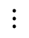
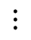
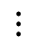
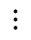
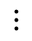
Methods – Supervised speech enhancement
10
10
0
0
-10
-10
0 1 2 3
0 1 2 3
Phase
STFT
ISTFT
Amplitude
Amplitude
4k
4k
2k
2k
0
DNN
0
0 1 2 3
0 1 2 3
Logspectrum
Feature
Spectrum
Recover
$$⋮$$
$$⋮$$
$$⋮$$
$$⋮$$
$$⋮$$
Notes:
Similar to the unsupervised SE system, the figure shows the flowchart of DDAE-based SE technique, which is a supervised system
Frame by frame

Slide 11
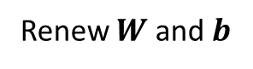
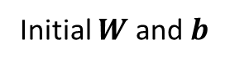
Supervised speech enhancement
DNN
3.model
1.Target
Logspectrum
Feature
Spectrum
Recover
$$⋮$$
$$⋮$$
$$⋮$$
$$⋮$$
$$⋮$$
Training stage
2.LOSS
Applying gradient decent to obtain all $W$ and $b$ parameters.
Initial $W$ and $b$
Referenced vector
4.Optimizer
Input vector
DNN
Output vector
Objective function
Gradient decent
Renew $W$ and $b$
Notes:
Similar to the unsupervised SE system, the figure shows the flowchart of DDAE-based SE technique, which is a supervised system
Frame by frame

Slide 12
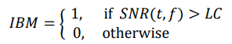
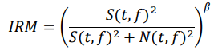
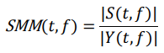
Target
Ideal Binary Mask
Ideal Ratio Mask
Spectral Magnitude Mask

Slide 13
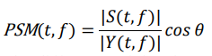
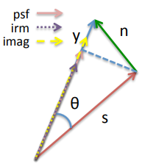
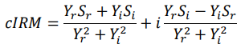
Target – Phase Issue
Wave form
Phase-Sensitive Mask
Complex Ideal Ratio Mask

Slide 14
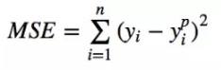
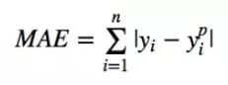
Loss & Model
Loss:
Mean Square Error (MSE)
Mean Absolute Error (MAE)
Model:
Deep Denoise Autoencoder (DDAE)
Fully Convolution network (FCN)
Long Short Time Memory (LSTM)

Slide 15
Optimizer
Stochastic Gradient Descent (SGD)
AdaGrad
RMSprop
Adam

Slide 16
Evaluation
perceptual evaluation of speech quality (PESQ)
short-time objective intelligibility (STOI)
segmental SNR (SSNR)
log-spectral distortion (LSD)

